Slide 1
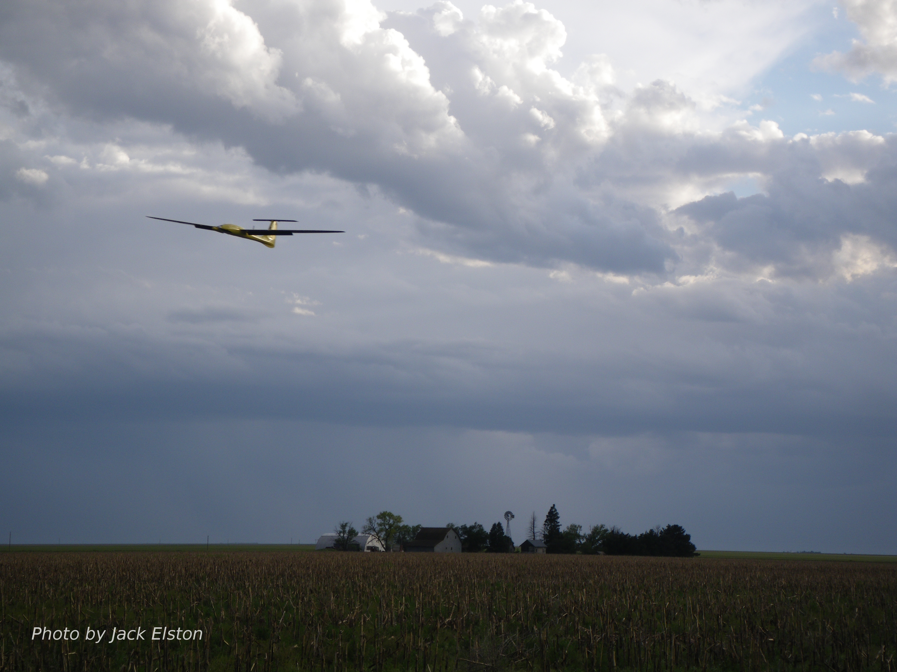
Chapter 2
Coordinate Frames

Slide 2
Reference Frames
In guidance and control of aircraft, reference frames are an essential idea
Describe relative position and orientation of objects
Aircraft relative to direction of wind
Camera relative to aircraft
Aircraft relative to inertial frame
Quantities most easily calculated or described in a specific reference frames:
Newton’s law
Aircraft attitude
Aerodynamic forces/torques
Accelerometers, rate gyros
GPS
Mission requirements
Must know how to transform
between different reference
frames

Slide 3


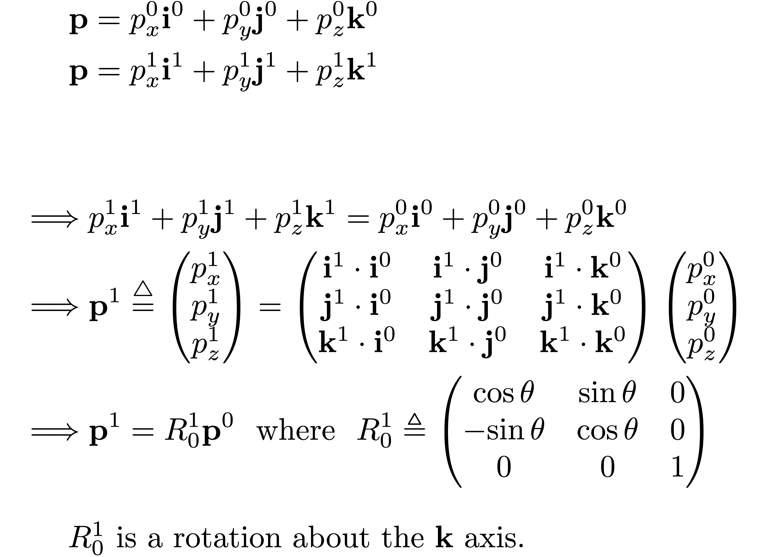
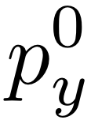


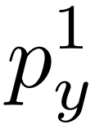
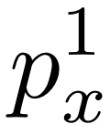


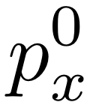

Rotation of Reference Frame
Notes:
\begin{align*}
\mathbf{p} &= p_x^0 \mathbf{i}^0 + p_y^0 \mathbf{j}^0 + p_z^0 \mathbf{k}^0 \\
\mathbf{p} &= p_x^1 \mathbf{i}^1 + p_y^1 \mathbf{j}^1 + p_z^1 \mathbf{k}^1 \\
\\
\\
\implies & p_x^1 \mathbf{i}^1 + p_y^1 \mathbf{j}^1 + p_z^1 \mathbf{k}^1 = p_x^0 \mathbf{i}^0 + p_y^0 \mathbf{j}^0 + p_z^0 \mathbf{k}^0 \\
\implies &
\mathbf{p}^1 \stackrel{\triangle}{=} \begin{pmatrix}
p_x^1 \\
p_y^1 \\
p_z^1
\end{pmatrix} = \begin{pmatrix}
\mathbf{i}^1 \cdot \mathbf{i}^0 & \mathbf{i}^1 \cdot \mathbf{j}^0 & \mathbf{i}^1 \cdot \mathbf{k}^0 \\
\mathbf{j}^1 \cdot \mathbf{i}^0 & \mathbf{j}^1 \cdot \mathbf{j}^0 & \mathbf{j}^1 \cdot \mathbf{k}^0 \\
\mathbf{k}^1 \cdot \mathbf{i}^0 & \mathbf{k}^1 \cdot \mathbf{j}^0 & \mathbf{k}^1 \cdot \mathbf{k}^0
\end{pmatrix} \begin{pmatrix}
p_x^0 \\
p_y^0 \\
p_z^0
\end{pmatrix} \\
\implies &
\mathbf{p}^1 = R_0^1 \mathbf{p}^0
\text{~~where~~}
R_0^1 \triangleq \begin{pmatrix}
\cos\theta & \sin\theta & 0 \\
-\!\sin\theta & \cos\theta & 0 \\
0 & 0 & 1
\end{pmatrix}
\end{align*}
$R_0^1$ is a rotation about the $\mathbf{k}$ axis.

Slide 4
Rotation of Reference Frame
Notes:
\noindent
Right-handed rotation about $\textbf{j}$ axis:
\[
R_0^1 \stackrel{\triangle}{=} \begin{pmatrix}
\cos\theta & 0 & -\!\sin\theta \\
0 & 1 & 0 \\
\sin\theta & 0 & \cos\theta
\end{pmatrix}
\]
\noindent
Right-handed rotation about $\textbf{i}$ axis:
\[
R_0^1 \stackrel{\triangle}{=} \begin{pmatrix}
1 & 0 & 0 \\
0 & \cos\theta & \sin\theta \\
0 & -\!\sin\theta & \cos\theta
\end{pmatrix}
\]
\noindent
Orthonormal matrix properties:
\begin{itemize}
\item[{\bf P.1.}] $(R_a^b)^{-1} = (R_a^b)^{\top} = R_b^a$
\item[{\bf P.2.}] $R_b^c R_a^b = R_a^c$
\item[{\bf P.3.}] $\det\!\left(R_a^b\right) = 1$
\end{itemize}

Slide 5
Rotation of Reference Frame: Alternate View
Notes:
\noindent Note that
\[
\mathbf{i}_0^0 = \begin{pmatrix} 1 \\ 0 \\ 0 \end{pmatrix},
\qquad
\mathbf{j}_0^0 = \begin{pmatrix} 0 \\ 1 \\ 0 \end{pmatrix},
\qquad
\mathbf{k}_0^0 = \begin{pmatrix} 0 \\ 0 \\ 1 \end{pmatrix}
\]
and that
\[
\mathbf{i}_1^1 = \begin{pmatrix} 1 \\ 0 \\ 0 \end{pmatrix},
\qquad
\mathbf{j}_1^1 = \begin{pmatrix} 0 \\ 1 \\ 0 \end{pmatrix},
\qquad
\mathbf{k}_1^1 = \begin{pmatrix} 0 \\ 0 \\ 1 \end{pmatrix}
\]
Now express $\mathbf{i}_0$, $\mathbf{j}_0$, $\mathbf{k}_0$ in the $1$-frame:
\[
\mathbf{i}_0^1 = \begin{pmatrix} \cos\theta \\ -\sin\theta \\ 0 \end{pmatrix},
\qquad
\mathbf{j}_0^1 = \begin{pmatrix} \sin\theta \\ \cos\theta \\ 0 \end{pmatrix},
\qquad
\mathbf{k}_0^1 = \begin{pmatrix} 0 \\ 0 \\ 1 \end{pmatrix}
\]
Therefore
\[
R_0^1 = \begin{pmatrix} \mathbf{i}_0^1 & \mathbf{j}_0^1 & \mathbf{k}_0^1 \end{pmatrix}
= \begin{pmatrix} \cos\theta & \sin\theta & 0 \\ -\sin\theta & \cos\theta & 0 \\ 0 & 0 & 1 \end{pmatrix}
\]

Slide 6




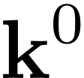
Rotation of a Vector
Notes:
\noindent
Let $p\defeq |\textbf{p}| = q\defeq |\textbf{q}|$, then
\begin{align*}
\textbf{p} &= \begin{pmatrix}
p\cos(\theta+\phi) \\
p\sin(\theta+\phi) \\
0
\end{pmatrix} \nonumber \\
&= \begin{pmatrix}
p\cos\theta\cos\phi-p\sin\theta\sin\phi \\
p\sin\theta\cos\phi+p\cos\theta\sin\phi \\
0
\end{pmatrix} \\
&= \begin{pmatrix}
\cos\theta &-\!\sin\theta &0 \\
\sin\theta &\cos\theta &0 \\
0 &0 &1
\end{pmatrix}
\begin{pmatrix}
p \cos \phi \\
p \sin \phi \\
0
\end{pmatrix}
\end{align*}
%where $p\defeq |\textbf{p}|$.
\noindent Define
\[
\textbf{q} = \begin{pmatrix}
p \cos \phi \\
p \sin \phi \\
0
\end{pmatrix}
\]
then
\[
\textbf{p} = (R_0^1)^{\top} \textbf{q} \qquad\implies\qquad
\textbf{q} = R_0^1 \textbf{p}
\]
---
$R_0^1$ can be interpreted as a left-handed rotation of a vector by an angle $\theta$

Slide 7
Passive vs. Active Rotation
Notes:
\noindent {\bf Passive Rotation/Transformation:} The vector $\mathbf{p}$ is stationary and the \\coordinate frame changes
\vspace{1cm}
\noindent {\bf Active Rotation/Transformation:} The coordinate frame remains fixed, but the vector is rotated
\vspace{1cm}
\noindent $R_0^1$ as defined earlier, represents a right-handed passive transformation, or a left-handed active transformation
\vspace{1cm}
\noindent If we stick with right-handed rotations, then $R_0^1$ represents a right-handed \\passive rotation, and $R_0^{1\top}$ represents a right-handed active rotation

Slide 8
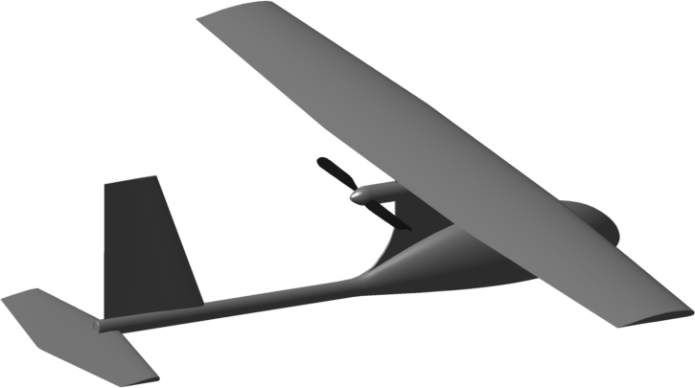
Inertial Frame and Vehicle Frame
Notes:
\begin{itemize}
\item Vehicle frame has same orientation\\
as inertial frame
\item Vehicle frame is fixed at cm of aircraft
\item Inertial and vehicle frames are referred\\
to as NED frames
\item $N \longrightarrow x$, $E \longrightarrow y$, $D \longrightarrow z$
\end{itemize}

Slide 9
Euler Angles
Need way to describe attitude of aircraft
Common approach: Euler angles
Pro: Intuitive
Con: Mathematical singularity
Quaternions are alternative for overcoming singularity
Notes:
$\psi$: heading (yaw)
\vspace{.5cm}
$\theta$: elevation (pitch)
\vspace{.5cm}
$\phi$: bank (roll)

Slide 10
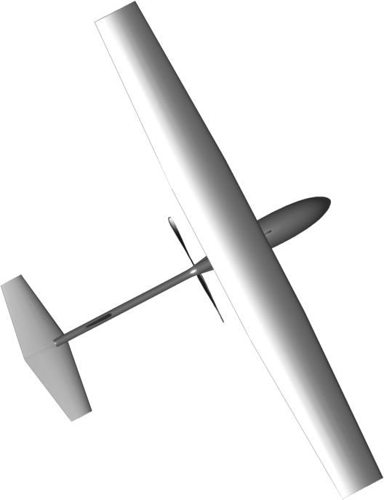
Vehicle-1 Frame
Notes:
\[
\mathcal{R}_v^{v1}(\psi) =
\begin{pmatrix}
\cos\psi & \sin\psi & 0 \\
-\sin\psi & \cos\psi & 0 \\
0 & 0 & 1
\end{pmatrix}
\]
gives
\[
\mathbf{p}^{v1} = \mathcal{R}_v^{v1}(\psi) \mathbf{p}^v
\]
where $\psi$ is the heading

Slide 11
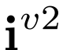
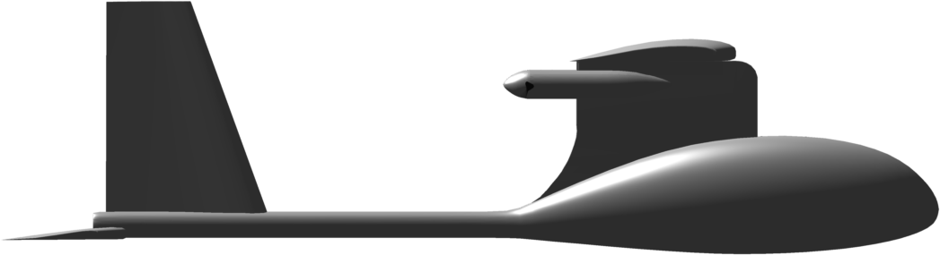
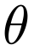
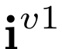
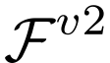
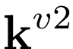
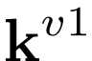
Vehicle-2 Frame
Notes:
\[
R_{v1}^{v2}(\theta) =
\begin{pmatrix}
\cos\theta& 0 & -\sin\theta \\
0 & 1 & 0 \\
\sin\theta & 0 & \cos\theta
\end{pmatrix}
\]
gives
\[
\mathbf{p}^{v2} = R_{v1}^{v2}(\theta) \mathbf{p}^{v1}
\]
where $\theta$ is the pitch angle

Slide 12
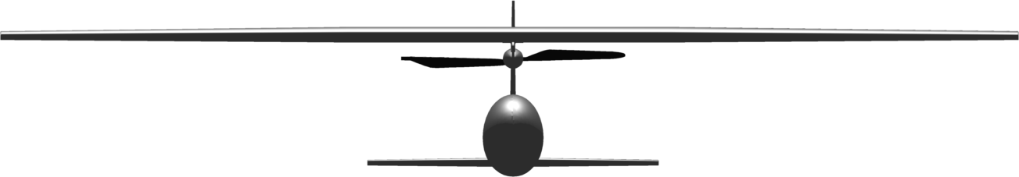
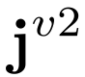
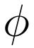
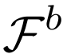
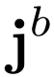
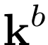
Body Frame
Notes:
\renewcommand{\textwidth}{2in}
\[
R_{v2}^{ b}(\phi) =
\begin{pmatrix}
1 & 0 & 0 \\
0 & \cos\phi & \sin\phi \\
0 & -\sin\phi & \cos\phi
\end{pmatrix}
\]
gives
\[
\mathbf{p}^{b} = R_{v2}^{ b}(\phi) \mathbf{p}^{v2}
\]
where $\phi$ is the roll (bank) angle

Slide 13
Inertial Frame to Body Frame Transformation
Notes:
\newcommand{\cth}{c_{\theta}}
\newcommand{\sth}{s_{\theta}}
\newcommand{\cps}{c_{\psi}}
\newcommand{\sps}{s_{\psi}}
\newcommand{\cph}{c_{\phi}}
\newcommand{\sph}{s_{\phi}}
\noindent Define
\begin{align*}R_{v}^{ b}(\phi,\theta,\psi) &= R_{v2}^{b}(\phi) R_{v1}^{v2}(\theta) R_{v}^{v1}(\psi) \\
&=
\begin{pmatrix}
1 & 0 & 0 \\
0 & \cos\phi & \sin\phi \\
0 & -\sin\phi & \cos\phi
\end{pmatrix}
\begin{pmatrix}
\cos\theta& 0 & -\sin\theta \\
0 & 1 & 0 \\
\sin\theta & 0 & \cos\theta
\end{pmatrix}
\begin{pmatrix}
\cos\psi & \sin\psi & 0 \\
-\sin\psi & \cos\psi & 0 \\
0 & 0 & 1
\end{pmatrix} \notag \\
&=
\begin{pmatrix}
\cth \cps & \cth \sps & -\sth \\
\sph \sth \cps - \cph \sps & \sph \sth \sps + \cph
\cps & \sph \cth \\
\cph \sth \cps + \sph \sps & \cph \sth \sps - \sph
\cps & \cph \cth
\end{pmatrix}
\end{align*}
to give
\[
\textbf{p}^{b} = R_{v}^{b}(\Theta) \textbf{p}^{v}
\]
where, $\Theta=(\phi, \theta, \psi)^\top$

Slide 14
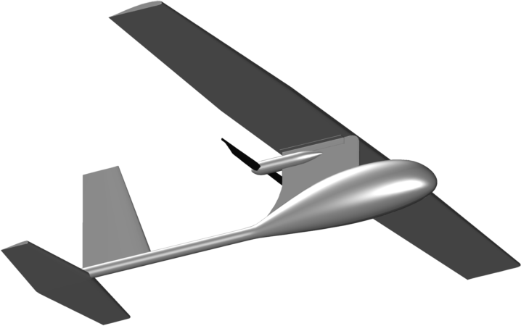
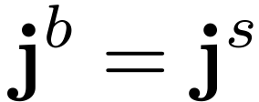



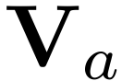
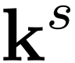
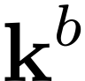
Stability Frame
Right-handed rotation
Stability frame helps us rigorously define angle of attack and is useful for analyzing stability of aircraft
Angle of attack defined as a positive RH rotation from stability to body frame
Notes:
% i^s is unit vector pointed in the direction of the projection of V_a onto the i^b-k^b plane. % The angle of attack is the angle between i^s and i^b.
\mathcal{R}_{s}^{b}(\alpha) &=
\begin{pmatrix}
\cos\alpha & 0 & -\sin\alpha \\
0 & 1 & 0 \\
\sin\alpha & 0 & \cos\alpha
\end{pmatrix} \\[0.4cm]
\mathbf{p}^{b} &= \mathcal{R}_{s}^{b}(\alpha) \mathbf{p}^{s} \\[0.4cm]
\mathbf{p}^{s} &= \mathcal{R}_{b}^{s}(\alpha) \mathbf{p}^{b} = \mathcal{R}_{s}^{b}(\alpha)^\top \mathbf{p}^{b}

Slide 15
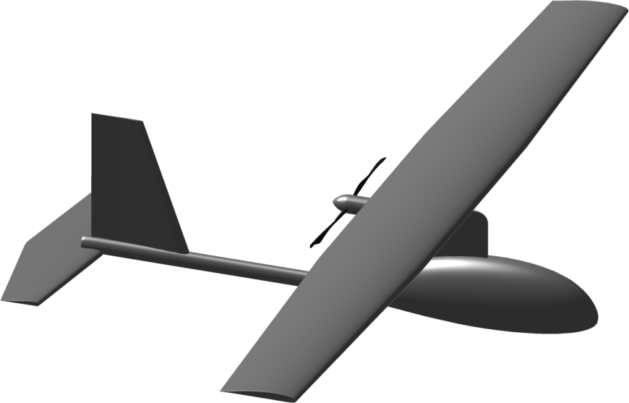
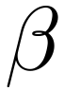



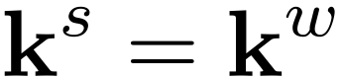
Wind Frame
Notes:
\begin{align*}
R_{s}^{w}(\beta) &=
\begin{pmatrix}
\cos\beta & \sin\beta & 0 \\
-\sin\beta & \cos\beta & 0 \\
0 & 0 & 1
\end{pmatrix}
\\ \\
\mathbf{p}^{w} &= R_{s}^{w}(\beta) \mathbf{p}^{s}
\\\\
R_{b }^{w}(\alpha,\beta) &= R_{s}^{w}(\beta) R_{b}^{s}(\alpha)\\
&= \begin{pmatrix}
\cos\beta & \sin\beta & 0 \\
-\sin\beta & \cos\beta & 0 \\
0 & 0 & 1
\end{pmatrix}
\begin{pmatrix}
\cos\alpha & 0 & \sin\alpha \\
0 & 1 & 0 \\
-\sin\alpha & 0 & \cos\alpha
\end{pmatrix} \\
&= \begin{pmatrix}
\cos\beta\cos\alpha & \sin\beta & \cos\beta\sin\alpha \\
-\sin\beta\cos\alpha & \cos\beta & -\sin\beta\sin\alpha \\
-\sin\alpha & 0 & \cos\alpha
\end{pmatrix}
\end{align*}

Slide 16
Wind Frame (continued)
Wind frame helps us rigorously define side-slip angle
Forces and moments are most naturally defined in wind frame
Side-slip angle is nominally zero for tailed aircraft
Notes:
% The wind frame helps to define the side-slip angle beta. The airspeed vector is in the direction represented by the unit vector i^w. The wind frame can be represented by rotating the stability frame about the k^s axis by an angle beta.
\[
R_{w}^{b}(\alpha,\beta) = (R_{b}^{w})^{\top}(\alpha,\beta) =
\begin{pmatrix}
\cos\beta\cos\alpha & -\sin\beta\cos\alpha & -\sin\alpha \\
\sin\beta & \cos\beta & 0 \\
\cos\beta\sin\alpha & -\sin\beta\sin\alpha & \cos\alpha
\end{pmatrix}
\]

Slide 17
Airspeed, Wind Speed, Ground Speed
a/c wrt to inertial frame
expressed in body frame
wind wrt to inertial frame
expressed in body frame
ground track
a/c wrt to surrounding air
expressed in body frame
Notes:
\begin{align*}
\mathbf{V}_a &= \mathbf{V}_g - \mathbf{V}_w
\\
\mathbf{V}_g^b &= \begin{pmatrix} u \\ v \\
w\end{pmatrix}
\\
\mathbf{V}_w^b &= \begin{pmatrix} u_w \\ v_w \\ w_w\end{pmatrix} =
R_{v}^{b}(\phi,\theta,\psi)
\begin{pmatrix} w_n \\ w_e \\ w_d \end{pmatrix}
\\
\mathbf{V}_a^w &= \begin{pmatrix} V_a \\ 0 \\
0\end{pmatrix}
\\
\mathbf{V}_a^b &= \begin{pmatrix} u_r \\ v_r \\ w_r \end{pmatrix} =
\begin{pmatrix} u - u_w \\ v - v_w \\ w - w_w \end{pmatrix}
\end{align*}

Slide 18
Airspeed, Angle of Attack, Sideslip Angle
OR
Notes:
\mathbf{V}_a^b &= \begin{pmatrix} u_r \\ v_r \\ w_r \end{pmatrix} =
R_{w}^{b}
\begin{pmatrix} V_a \\ 0 \\ 0 \end{pmatrix}
\\
&= \begin{pmatrix}
\cos\beta\cos\alpha & -\sin\beta\cos\alpha & -\sin\alpha \\
\sin\beta & \cos\beta & -\sin\beta\sin\alpha \\
\cos\beta\sin\alpha & 0 & \cos\alpha
\end{pmatrix} \begin{pmatrix} V_a \\ 0 \\ 0 \end{pmatrix}
\begin{pmatrix} u_r \\ v_r \\ w_r \end{pmatrix} =
V_a \begin{pmatrix} \cos\alpha \cos\beta \\ \sin\beta
\\ \sin\alpha\cos\beta \end{pmatrix}
V_a &= \sqrt{u_r^2 + v_r^2 + w_r^2} \notag \\
\alpha &= \tan^{-1}\left(\frac{w_r}{u_r}\right) \label{eq:frames-Valphabeta-to-uvw} \\
\beta &= \tan^{-1}\left( \frac{v_r}{\sqrt{u_r^2+w_r^2}} \right)

Slide 19
Course and Flight Path Angles
horizontal component
of groundspeed vector
Flight path projected onto ground
Notes:
$\gamma$: flight path angle
$\chi$: course angle

Slide 20
Wind Triangle
north
ground track
Notes:
$\chi$: course angle
$\psi$: heading angle
$\beta$: side slip angle
$\chi_c$: crab angle
$\chi_w$: wind direction
\chi_c \defeq \chi - \psi

Slide 21
Wind Triangle
Notes:
$\theta$: pitch angle
$\alpha$: angle of attack
$\gamma$: flight path angle
$\gamma_a$: air-mass-relative flight path angle
\gamma_a = \theta-\alpha

Slide 22
When wind speed and sideslip are zero…
Notes:
\noindent If both the windspeed and the sideslip angles are zero, i.e.,
\begin{align*}
V_w &= 0 \\
\beta &= 0
\end{align*}
then we have the following simplifications
\begin{align*}
V_a &= V_g \text{~~~Airspeed equals groundspeed} \\
u &= u_r \text{~~~Velocity equals velocity relative to the air mass}\\
v &= v_r \\
w &= w_r \\
\psi &= \chi \text{~~~Heading equals course} \\
\gamma &= \gamma_a \text{~~~Flight path angle equals air-mass-referenced flight path angle}
\end{align*}

Slide 23


Differentiation of a Vector
Notes:
\mathbf{p} &= p_x \mathbf{i}^b + p_y \mathbf{j}^b + p_z \mathbf{k}^b
\\[4pt]
\frac{d}{dt_i}{\mathbf{p}} &= \dot{p}_x \mathbf{i}^b + \dot{p}_y \mathbf{j}^b + \dot{p}_z \mathbf{k}^b
+ p_x \frac{d}{dt_i}\mathbf{i}^b + p_y \frac{d}{dt_i}\mathbf{j}^b + p_z \frac{d}{dt_i}\mathbf{k}^b
\\[4pt]
\frac{d}{dt_b}\mathbf{p} &= \dot{p}_x \mathbf{i}^b + \dot{p}_y \mathbf{j}^b + \dot{p}_z \mathbf{k}^b
\\[6pt]
\dot{\mathbf{i}}^b &= \boldsymbol{\omega}_{b/i} \times \mathbf{i}^b \\
\dot{\mathbf{j}}^b &= \boldsymbol{\omega}_{b/i} \times \mathbf{j}^b \\
\dot{\mathbf{k}}^b &= \boldsymbol{\omega}_{b/i} \times \mathbf{k}^b \\[6pt]
p_x \dot{\mathbf{i}}^b &+ p_y \dot{\mathbf{j}}^b + p_z \dot{\mathbf{k}}^b
= p_x (\boldsymbol{\omega}_{b/i} \times \mathbf{i}^b)
+ p_y (\boldsymbol{\omega}_{b/i} \times \mathbf{j}^b)
+ p_z (\boldsymbol{\omega}_{b/i} \times \mathbf{k}^b) \nonumber \\
&\qquad\qquad\qquad = \boldsymbol{\omega}_{b/i} \times \mathbf{p}
\\[4pt]
\frac{d}{dt_i}\mathbf{p} &= \frac{d}{dt_b}\mathbf{p} + \boldsymbol{\omega}_{b/i}
\times\mathbf{p}

Slide 24
Project Aircraft
16
12
8
11
6
7
15
13
2
14
3
1
9
5
4
10

Slide 25
Project Aircraft
fuse_l3
fuse_l1
fuse_l2
wing_l
tail_h
fuse_h
tailwing_l

Slide 26
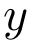
Project Aircraft
fuse_w
fuse_l1
fuse_l2
wing_l
fuse_l3
wing_w
tailwing_l
tailwing_w

